Slide 1

Na Diffusion in NaSiCON
Zeyu Deng (Jerry)

Slide 2
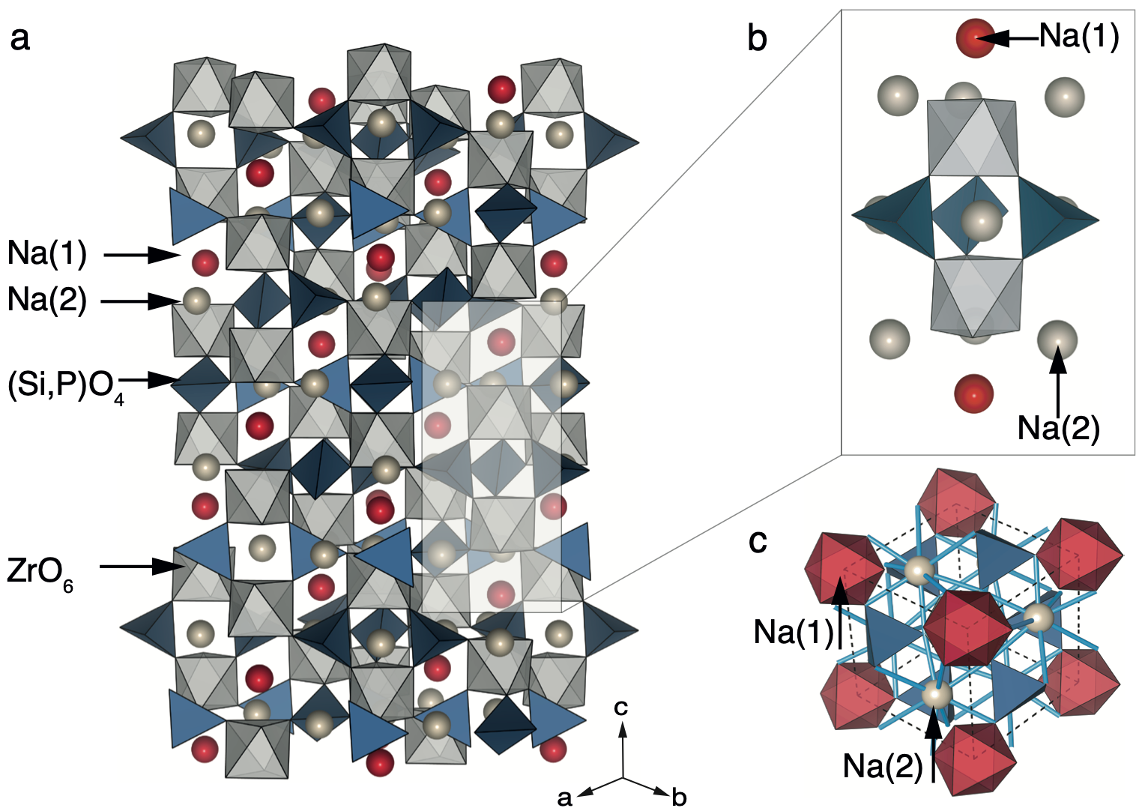
Natrium Superionic CONductor (NaSiCON)
Na_{1+x}Zr₂Si_{x}P_{3-x}O₁₂ (0 ≤ x ≤ 3)
High conductivity: 15 mS/cm at x = 2 ~ 2.4 studied by Hong and Goodenough in 1976 for the rhombohedral phase
2 Na(1) sites, 6 Na(2) sites and 6 Si/P sites
Phase behavior knowledge and kinetics are limited because of the complexity of the crystal structure
Challenges: Disordering, large structure and flat energy landscapes.
Deng, Z.; Sai Gautam, G.; Kolli, S. K.; Chotard, J.-N.; Cheetham, A. K.; Masquelier, C.; Canepa, P. Phase Behavior in Rhombohedral NaSiCON Electrolytes and Electrodes. Chem. Mater. 2020, acs.chemmater.0c02695.
Goodenough, J. B.; Hong, H. Y.-P.; Kafalas, J. A. Fast Na+-Ion Transport in Skeleton Structures. Mat. Res. Bul. 1976, 11 (2), 203–220.

Slide 3
Calculate the Kinetics of Na in NaSiCON from First Principle
Model Construction
build_model.py
Model Fitting
fit_model.py
Kinetic Monte Carlo
run_kmc.py
Results Analysis
Diffusivity
Conductivity
kmc.py
gather_mc_data.py
DFT-NEB Simulations
NEB = nudged elastic band
Canonical Monte Carlo Simulations
Basis (Clusters)
NEB Barriers
Hamiltonian
Initial Structures
Why Kinetic Monte Carlo (KMC)?
Speed and accuracy
Direct calculation using structure-property relationship
Properties at finite temperature and different composition
For complex and disordered structure
Trajectories

Slide 4
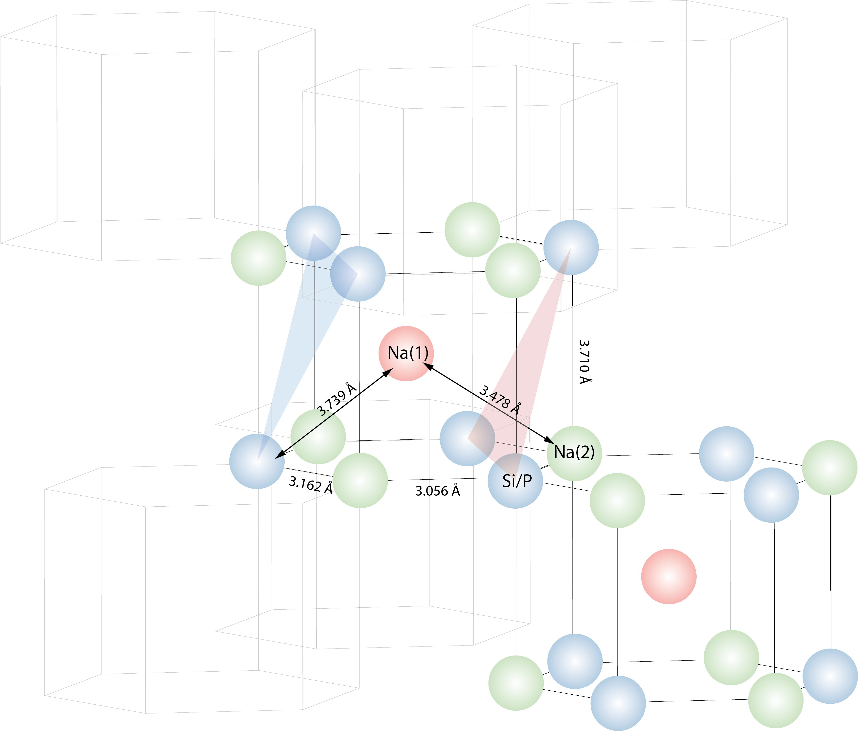
Model Construction
4 Å

Slide 5
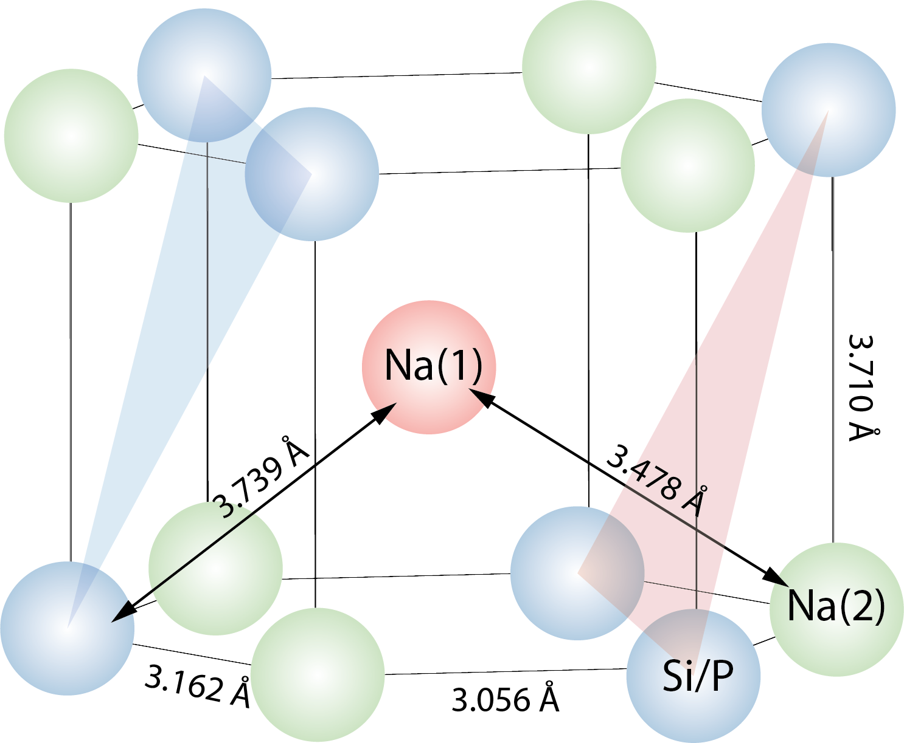
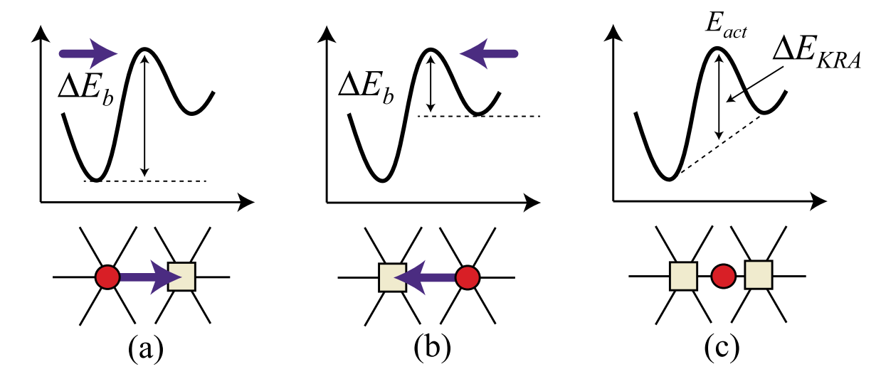
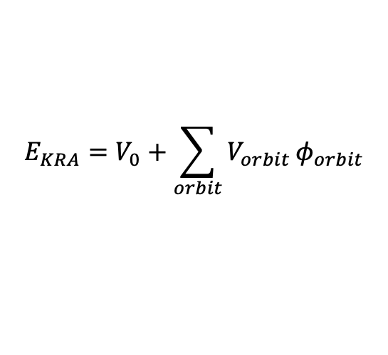
Model Construction
Diffusion is always between a Na(1) site and a Na(2) site
Diffusion barrier is a local property and can be approximated by the kinetically resolved barrier E_{KRA}
V_{orbit} is the kinetic effective cluster interactions (KECI), V₀ is the empty cluster and ɸ_{orbit} is the cluster function for each orbit
A series of E_{KRA} were computed for different local environments (occupations) and then V_{orbit} and V₀ can be fitted from equation
$$E_{KRA}=V_{0}+\sum_{orbit}{V_{orbit}}φ_{orbit}$$
A. Van Der Ven, Z. Deng, S. Banerjee and S. P. Ong, Chem. Rev., 2020, 120, 6977–7019.

Slide 6
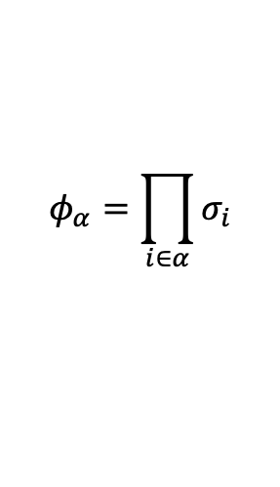
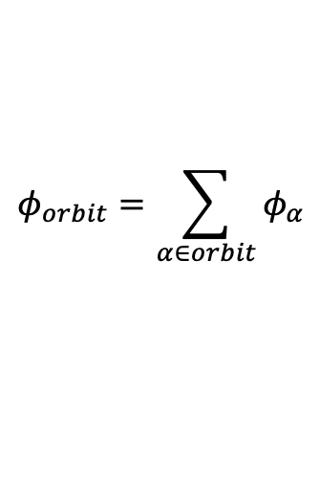
Model Construction
A cluster (𝛼) is a collection of sites (i) (not atom)
An orbit (o) is a collection of symmetrically equivalent clusters
A diffusion event is a diffusion between 2 Na sites with information of the orbit and cluster around it
Occupation (σ) is ±1 for each sites depends on its occupation, e.g. Na or Vacancy (Chebyshev basis)
Cluster function (ɸ) is the product of all occupations in this cluster
Correlation (ɸ_{o}) is a vector of summation of all symmetrically grouped cluster functions for each orbit (ɸ_{𝛼})
$$φ_{α}=\prod_{i∈α}{σ_{i}}$$
Cluster
cluster type
structure
Orbit
clusters
multiplicity
Event
na1_index
na2_index
sym
max_length
min_length
bond_distances
sorted_sublattice_index
occ_sublat
ekra
probability
corr
get_cluster_function()
get_cluster_function()
LocalClusterExpansion
clusters
orbits
sublattice_indices
cluster_constructor()
orbit_constructor()
$$φ_{orbit}=\sum_{α∈orbit}{φ_{α}}$$

Slide 7
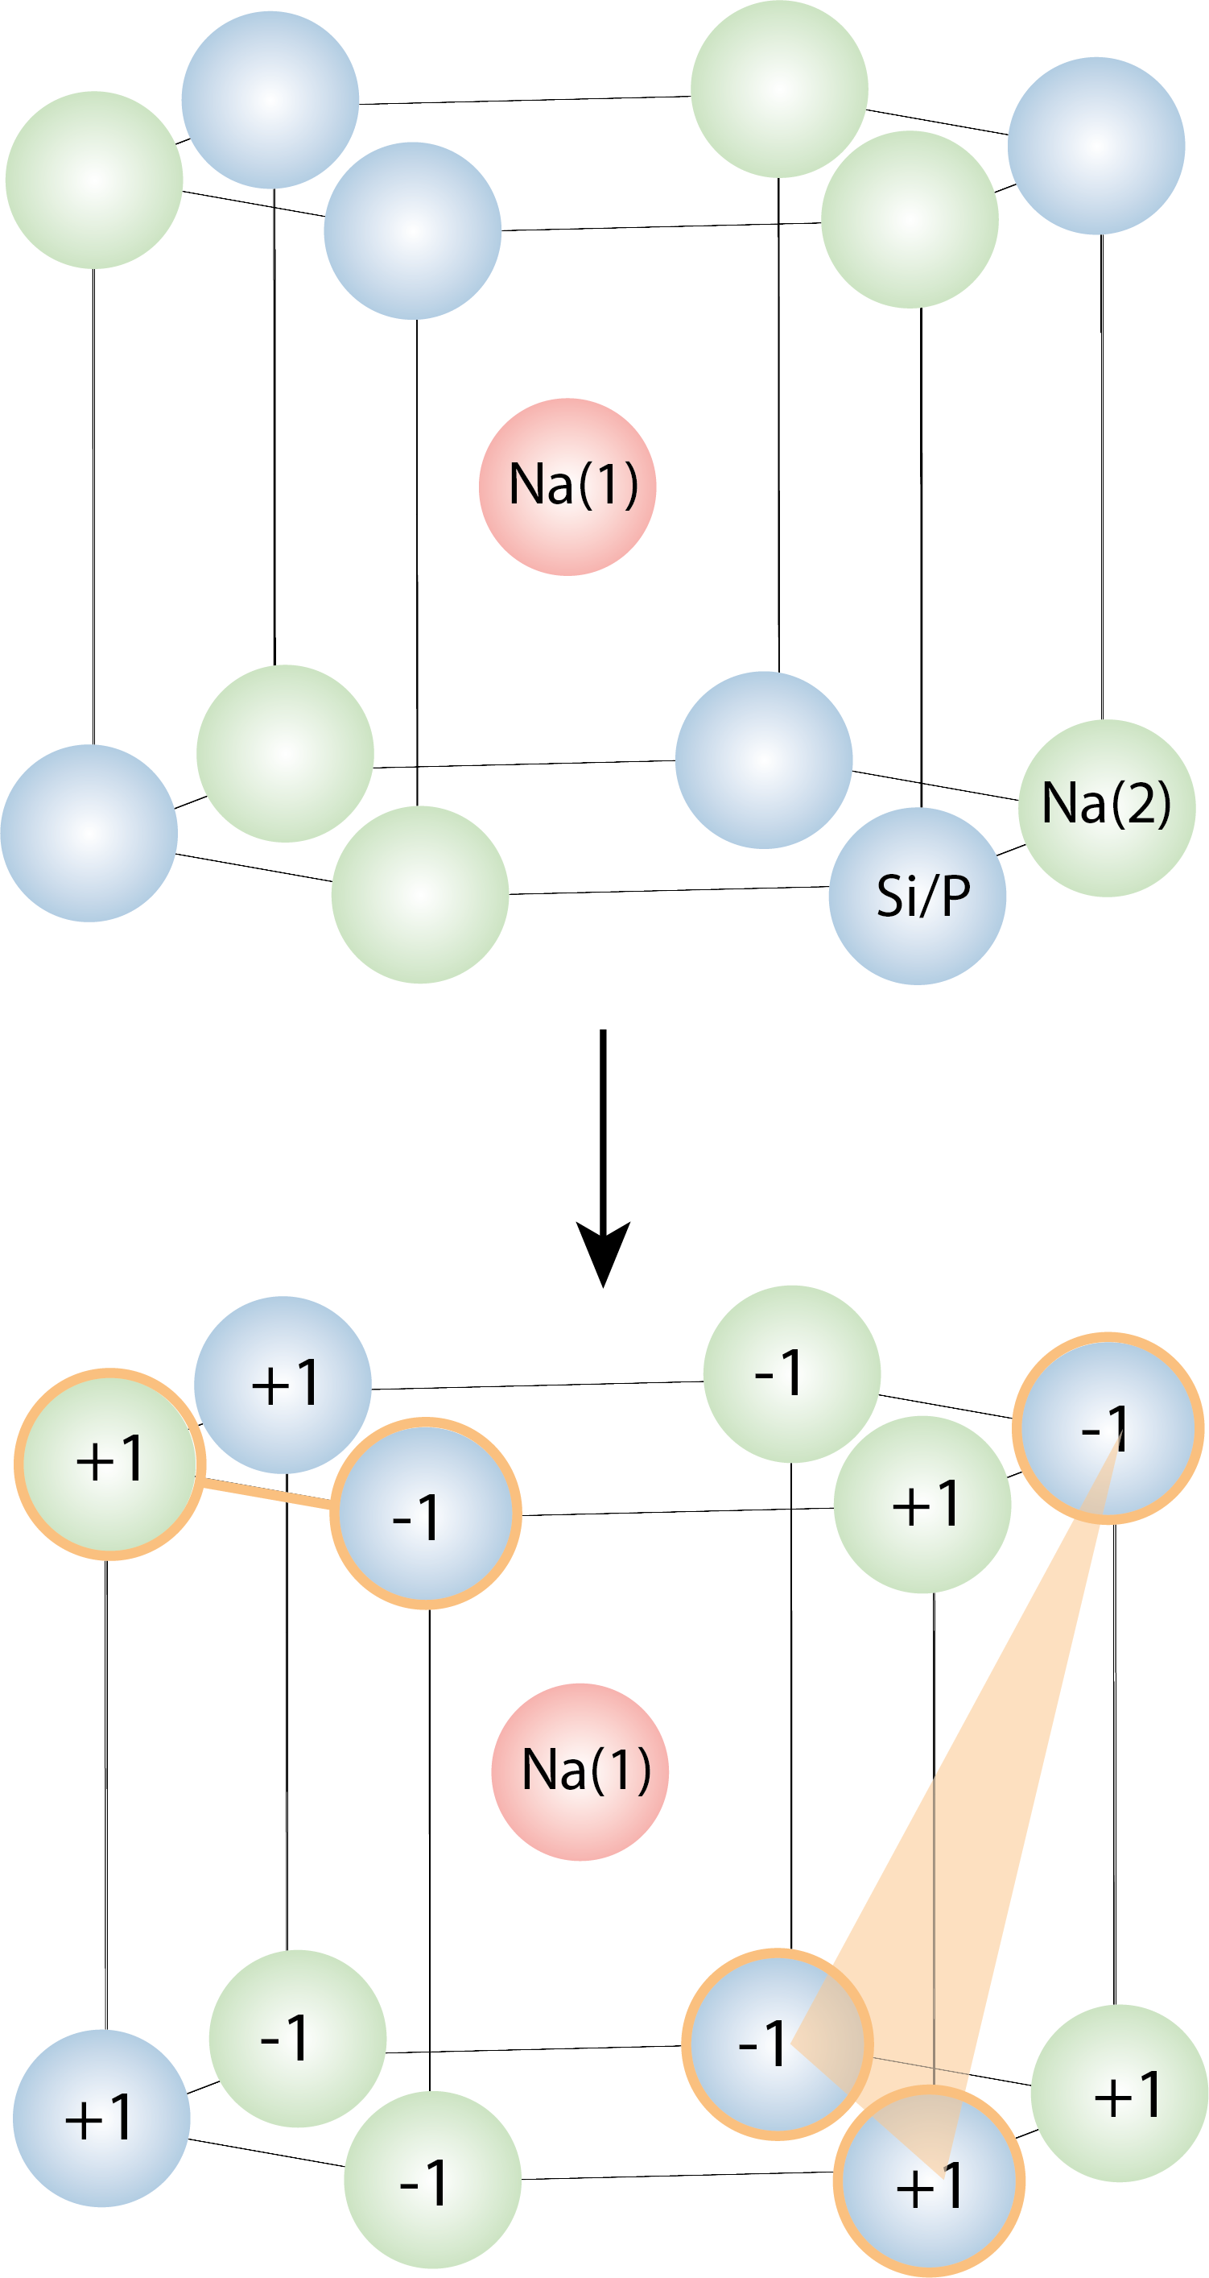
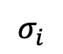
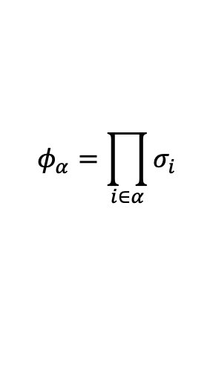
Model Construction
Type | Site Index | max_length | min_length | Multiplicity
point | (0,) | 0 | 0 | 6
point | (6,) | 0 | 0 | 6
pair | (0, 1) | 4.727 | 4.727 | 6
pair | (0, 3) | 5.103 | 5.103 | 6
pair | (0, 6) | 3.71 | 3.71 | 6
pair | (0, 7) | 3.056 | 3.056 | 6
pair | (0, 8) | 3.162 | 3.162 | 6
pair | (0, 9) | 6.492 | 6.492 | 6
pair | (0, 11) | 6.196 | 6.196 | 6
pair | (6, 7) | 4.922 | 4.922 | 6
pair | (6, 9) | 5.629 | 5.629 | 6
triplet | (0, 1, 6) | 4.727 | 3.162 | 6
Na, Si = -1
Va, P = +1
$$σ_{i}$$
$$φ_{α}=\prod_{i∈α}{σ_{i}}$$
13 Orbits generated using cutoffs: pair = 6.5 Å, triplet = 4.8 Å, quadruplet = 0.0 Å

Slide 8
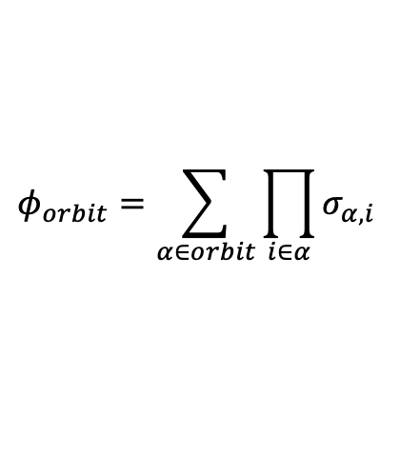
Model Construction
$$φ_{orbit}=\sum_{α∈orbit}{\prod_{i∈α}{σ_{α,i}}}$$
Occupation (σ_{i}) used for DFT NEB calculations:
Correlation (ɸ_{orbit}) computed from occupation
i_{site}
m_{orbit}
0_0Si3P_0Si3P.cif [1, 1, 1, 1, 1, 1, 1, 1, 1, 1, 1, 1]
2_0Si3P_0Si3P.cif [1, -1, -1, -1, -1, 1, 1, 1, 1, 1, 1, 1]
2_0Si3P_1Si2P.cif [1, -1, -1, -1, -1, 1, 1, 1, 1, -1, 1, 1]
2_0Si3P_2Si1P.cif [1, -1, -1, -1, -1, 1, 1, 1, 1, -1, 1, -1]
2_0Si3P_3Si0P.cif [1, -1, -1, -1, -1, 1, 1, 1, 1, -1, -1, -1]
2_0Si3P_3Si0P_CB.cif [1, 1, -1, -1, -1, 1, 1, 1, 1, -1, -1, -1]
2_1Si2P_1Si2P.cif [1, -1, -1, -1, -1, 1, 1, 1, -1, -1, 1, 1]
2_1Si2P_2Si1P.cif [1, -1, -1, -1, -1, 1, 1, 1, -1, -1, 1, -1]
2_1Si2P_2Si1P_CB.cif [1, 1, -1, -1, -1, 1, 1, 1, -1, -1, 1, -1]
2_1Si2P_3Si0P.cif [1, -1, -1, -1, -1, 1, 1, 1, -1, -1, -1, -1]
2_2Si1P_2Si1P.cif [1, -1, -1, -1, -1, 1, -1, 1, -1, -1, 1, -1]
2_2Si1P_3Si0P.cif [1, -1, -1, -1, -1, 1, -1, 1, -1, -1, -1, -1]
2_3Si0P_3Si0P.cif [1, -1, -1, -1, -1, 1, -1, -1, -1, -1, -1, -1]
3_3Si0P_3Si0P.cif [1, -1, -1, -1, -1, -1, -1, -1, -1, -1, -1, -1]
[[ 6. 6. 6. 6. 6. 6. 6. 6. 6. 6. 6. 6. 6.]
[-2. 6. -2. -2. -2. -2. -2. -2. -2. 6. 6. -2. -2.]
[-2. 4. -2. -2. 0. 0. -4. -4. 0. 2. 2. 0. -4.]
[-2. 2. -2. -2. -2. 2. -2. -2. -2. 2. -2. 2. -2.]
[-2. 0. -2. -2. 0. 0. 0. 0. 0. 2. -2. 0. 0.]
[ 0. 0. -2. -2. 2. -2. 2. -2. -2. 2. -2. 0. 4.]
[-2. 2. -2. -2. 2. 2. -6. -6. 2. -2. -2. 2. -6.]
[-2. 0. -2. -2. 0. 4. -4. -4. 0. -2. -2. 4. -4.]
[ 0. 0. -2. -2. 2. 2. -2. -6. 2. -2. -2. 4. 0.]
[-2. -2. -2. -2. 2. 2. -2. -2. 2. 2. -2. 2. -2.]
[-2. -2. -2. -2. -2. 6. -2. -2. -2. -2. -2. 6. -2.]
[-2. -4. -2. -2. 0. 4. 0. 0. 0. 2. 2. 4. 0.]
[-2. -6. -2. -2. 2. 2. 2. 2. 2. 6. 6. 2. 2.]
[-4. -6. 2. 2. 4. 4. 4. 4. 4. 6. 6. -2. -2.]]
n_{sample}
n_{sample}
σ[site0]
σ[site11]
ɸ[orbit0]
ɸ[orbit12]

Slide 9
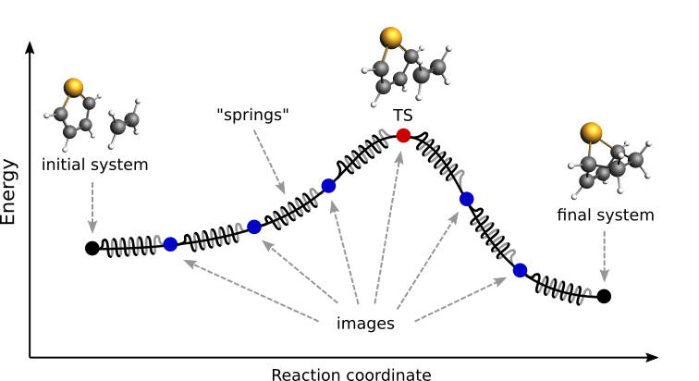
DFT-NEB calculations
NEB = nudged elastic band
https://www.scm.com/doc/AMS/Tasks/NEB.html

Slide 10
DFT-NEB calculations
x = 2 for different local Si/P environment
Na_{1+x}Zr₂Si_{x}P_{3-x}O₁₂ (0 ≤ x ≤ 3)
Na(2)
Na(2)
x ~ 0
Na(1)
Na(2)
try 2x2x1 cell
Na(1)
Na(1)
x ~ 3
Na(2)
Na(1)

Slide 11
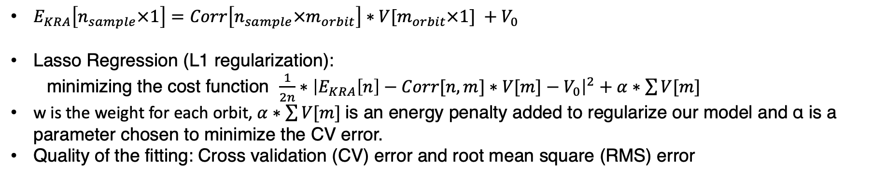
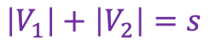
Model Fitting
Linear regression minimum
V₁
over fit
Prediction Error
under fit
Lasso regression minimum
V₂
$$\left|V_{1}\right|+\left|V_{2}\right|=s$$
Model Complexity
$E_{KRA}\left[n_{sample}×1\right]=Corr\left[n_{sample}×m_{orbit}\right]∗V[m_{orbit}×1] +V_{0}$
Lasso Regression (L1 regularization):
minimizing the cost function $\frac{1}{2n}∗{\left|E_{KRA}\left[n\right]−Corr[n,m]∗V[m]−V_{0}\right|}^{2}+α∗\sum{V[m]}$
w is the weight for each orbit, $α∗\sum{V[m]}$ is an energy penalty added to regularize our model and ɑ is a parameter chosen to minimize the CV error.
Quality of the fitting: Cross validation (CV) error and root mean square (RMS) error

Slide 12
Model Fitting
Lasso Results:
KECI =
[ 0. 5.8 -4.47 -0. -12.94 -0. -0. -2.73 -5.09 0.
0. 3.85 0. ]
There are 6 Non Zero KECI
Empty Cluster =
314.08731330138085
index NEB LCE NEB-LCE
[[ 1. 236.15 220.66 15.49]
[ 2. 445.75 391.63 54.12]
[ 3. 352.85 357.13 -4.28]
[ 4. 397.35 383.84 13.51]
[ 5. 313.08 342.76 -29.69]
[ 6. 268.3 323.03 -54.73]
[ 7. 320.62 312.78 7.83]
[ 8. 307. 322.64 -15.64]
[ 9. 186.35 239.62 -53.27]
[ 10. 394.09 318.75 75.34]
[ 11. 301.15 288.53 12.62]
[ 12. 346.65 376.06 -29.41]
[ 13. 315.9 315.25 0.65]
[ 14. 311.95 254.43 57.52]
[ 15. 153.15 179.62 -26.47]]
CV = 75.12 meV
RMSE = 37.51 meV
Type | Site Index
point | (0,)
point | (6,)
pair | (0, 1)
pair | (0, 3)
pair | (0, 6)
pair | (0, 7)
pair | (0, 8)
pair | (0, 9)
pair | (0, 11)
pair | (6, 7)
pair | (6, 9)
triplet | (0, 1, 6)
Predicted E_{KRA} vs DFT calculated E_{KRA}

Slide 13
All barriers from local cluster expansion
charge neutral structure only
0_0Si3P_0Si3P.cif [1, 1, 1, 1, 1, 1, 1, 1, 1, 1, 1, 1]

Slide 14
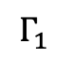
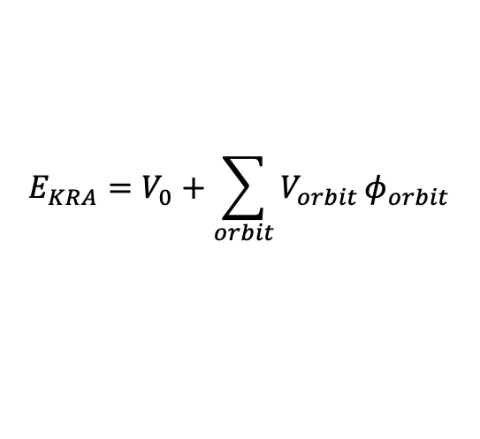
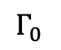
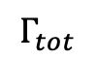
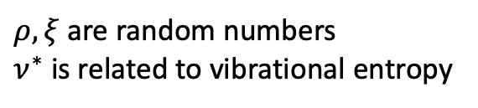
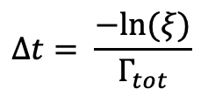
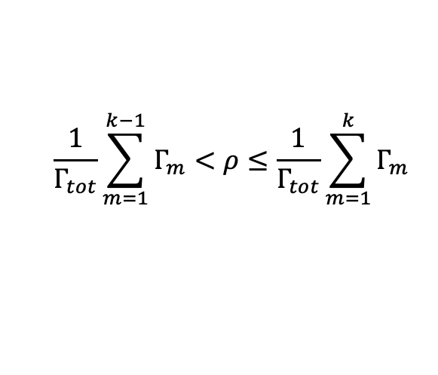
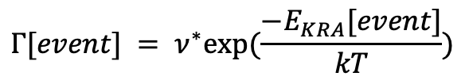
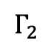
Kinetic Monte Carlo
Run KMC
Event propose
Single KMC run
Initialization
Propose Event
Update Event
Summary
occupation, correlation, E_{KRA,} probability and time
Na diffusion
Update Tracker
displacement for each Na
Na location, hop_counter
events and tracker
calculate D_{J}, D*, f and conductivity
$$\frac{1}{Γ_{tot}}\sum_{m=1}^{k−1}{Γ_{m}}<ρ≤\frac{1}{Γ_{tot}}\sum_{m=1}^{k}{Γ_{m}}$$
Generate Events
Load Occupations
Events Initialization
Compute the corr, ekra and probability for all events
Run KMC
only need one time for all calculations
from canonical monte carlo simulation
Rejection free KMC
…
$$Γ_{0}$$
$$Γ_{1}$$
$$Γ_{2}$$
$$Γ_{tot}$$
Event update
repeat n_kmc steps
$$E_{KRA}=V_{0}+\sum_{orbit}{V_{orbit}}φ_{orbit}$$
repeat n input structures
Event
na1_index
na2_index
sorted_sublattice_index
occ_sublat
ekra
probability
corr
Tracker
na_locations
hop_counter
displacements
calc_D_J()
calc_D_tracer()
calc_correlation()
calc_conductivity()
$$Γ[event] = ν^{∗}exp⁡(\frac{−E_{KRA}[event]}{kT})$$
$$∆t= \frac{−ln⁡(ξ)}{Γ_{tot}}$$
$ρ, ξ$ are random numbers
$ν^{∗}$ is related to vibrational entropy

Slide 15
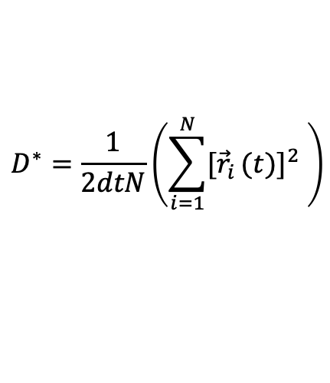
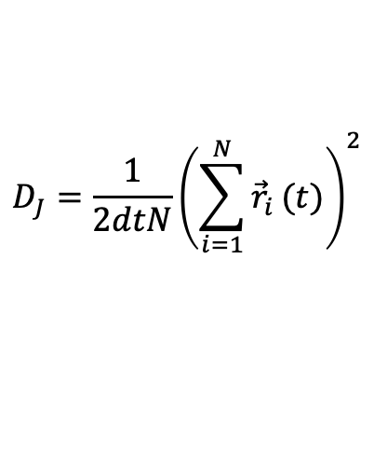
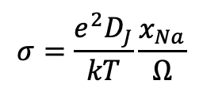
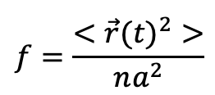
Kinetic Monte Carlo
Run KMC
Initialization
Propose Event
Update Event
Summary
occupation, correlation, E_{KRA,} probability and time
Na diffusion
Update Tracker
displacement for each Na
Na location, hop_counter
events and tracker
calculate D_{J}, D*, f and conductivity
Tracker stores information for each Na
Na | Na_locations | Displacement r(t)-r(0) | hop_counter
0 | 4 | [-10,3,12] | 138
1 | 20 | [4,2,1] | 152
2 | 5 |  | 146
… | … | … | …
n_Na | 3 | [23,21,52] | 165
Tracker has functions to analyze trajectory
repeat n_kmc steps
$$D_{J}=\frac{1}{2dtN}{\left(\sum_{i=1}^{N}{{\vec{r}}_{i}}(t)\right)}^{2}$$
$$σ=\frac{e^{2}D_{J}}{kT}\frac{x_{Na}}{Ω}$$
Tracker
na_locations
hop_counter
displacements
calc_D_J()
calc_D_tracer()
calc_correlation()
calc_conductivity()
$$D^{∗}=\frac{1}{2dtN}\left({\sum_{i=1}^{N}{{[\vec{r}}_{i}}(t)]}^{2} \right)$$
$$f=\frac{<{\vec{r}(t)}^{2}>}{na^{2}}$$
n = <hop_counter>
a = 3.478 Å

Slide 16
Resource Estimation
Total number of KMC runs for at a single temperature:
25 pass * 100 structures * 13 compositions * 8*8*8*8 Na/Va sites = 133.12*10⁶ KMC steps
Time costs to complete these KMC runs at a single temperature using 8 nodes on NSCC
133.12*10⁶ KMC steps / 3800 steps per min per core / 60 mins per hr / 24 cores/8 nodes = 3.04 hrs

Slide 17
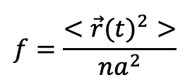
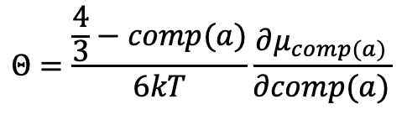
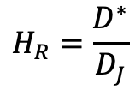
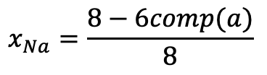
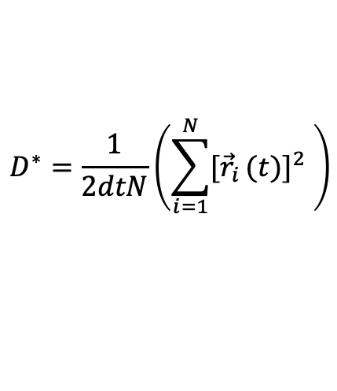
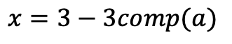
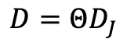
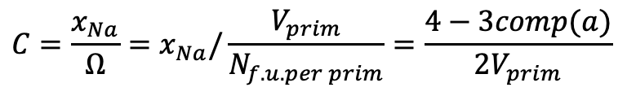
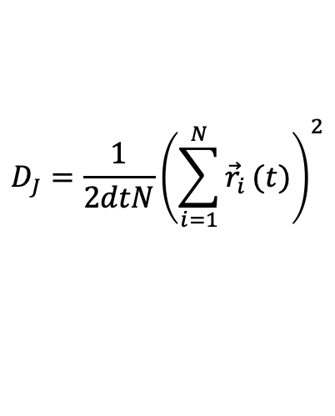
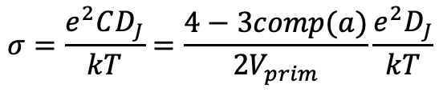
Clarification of some Terminologies
$$x_{Na}=\frac{8−6comp(a)}{8}$$
comp(a) is the parametric composition
$$x=3−3comp(a)$$
Concentration
Thermodynamic factor
Jump Diffusion Coefficient D_{J}
Diffusion Coefficient D
Tracer Diffusion Coefficient D*
Haven’s ratio
Correlation factor
Conductivity
$$Θ=\frac{\frac{4}{3}−comp(a)}{6kT}\frac{∂μ_{comp(a)}}{∂comp(a)}$$
Thermodynamic factor = 1 for non interacting intercalation (dilute), deviate 1 for ordering and high x
$$D_{J}=\frac{1}{2dtN}{\left(\sum_{i=1}^{N}{{\vec{r}}_{i}}(t)\right)}^{2}$$
D_J is usually greater than D* because there are interactions among Na
$$D=ΘD_{J}$$
$$D^{∗}=\frac{1}{2dtN}\left({\sum_{i=1}^{N}{{[\vec{r}}_{i}}(t)]}^{2} \right)$$
$$H_{R}=\frac{D^{∗}}{D_{J}}$$
H_{R} = 1 for no correlation between diffusing atoms, for electrolyte (constant x and nondilute), H_{R} is less than 1
$$f=\frac{<{\vec{r}(t)}^{2}>}{na^{2}}$$
f = 1 for no correlation between successive hops of the same atom
$$σ=\frac{e^{2}CD_{J}}{kT}=\frac{4−3comp(a)}{2V_{prim}}\frac{e^{2}D_{J}}{kT}$$
$$C=\frac{x_{Na}}{Ω}=x_{Na}/\frac{V_{prim}}{N_{f.u. per prim}}=\frac{4−3comp(a)}{2V_{prim}}$$

